Slide 1

GitHub: Building Your Coding Profile
Teaching Assistants
Boston University
Mar. 24th, 2025

Slide 2
GitHub
“collaborative, open sharing
in the programming world”

Slide 3
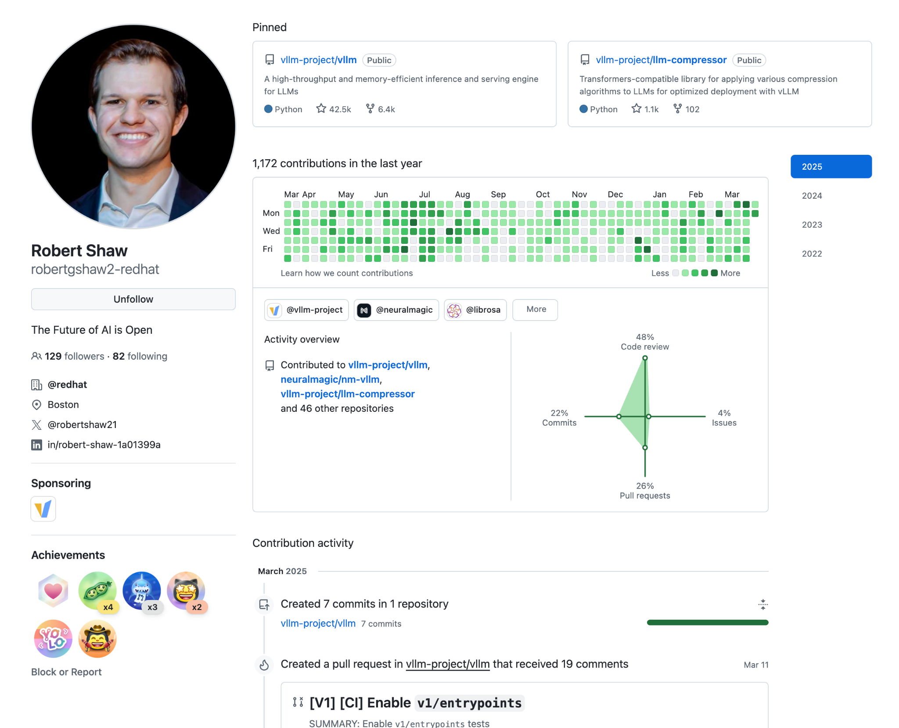
Open-source Projects
Contributions
Commits, Code Review, Issues, Pull Request
Credit: https://github.com/robertgshaw2-redhat

Slide 4
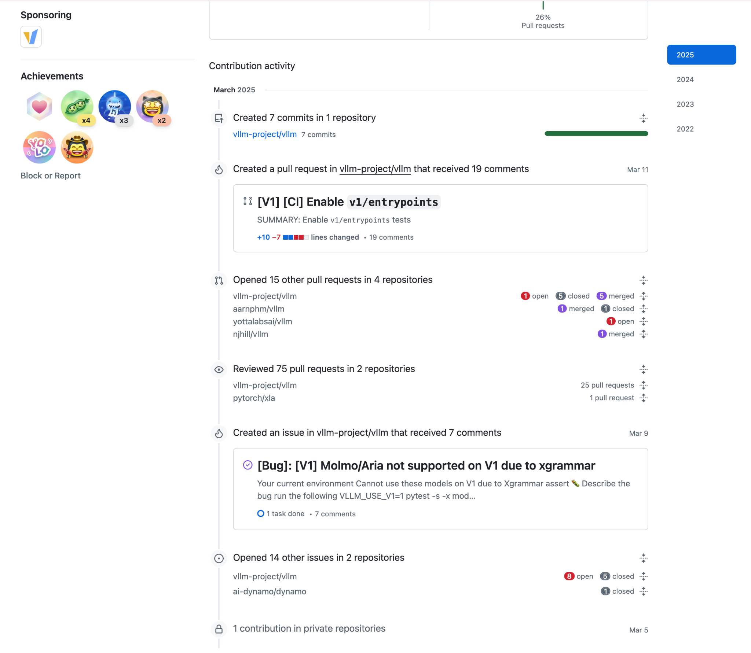
Specific
Contributions
Credit: https://github.com/robertgshaw2-redhat

Slide 5
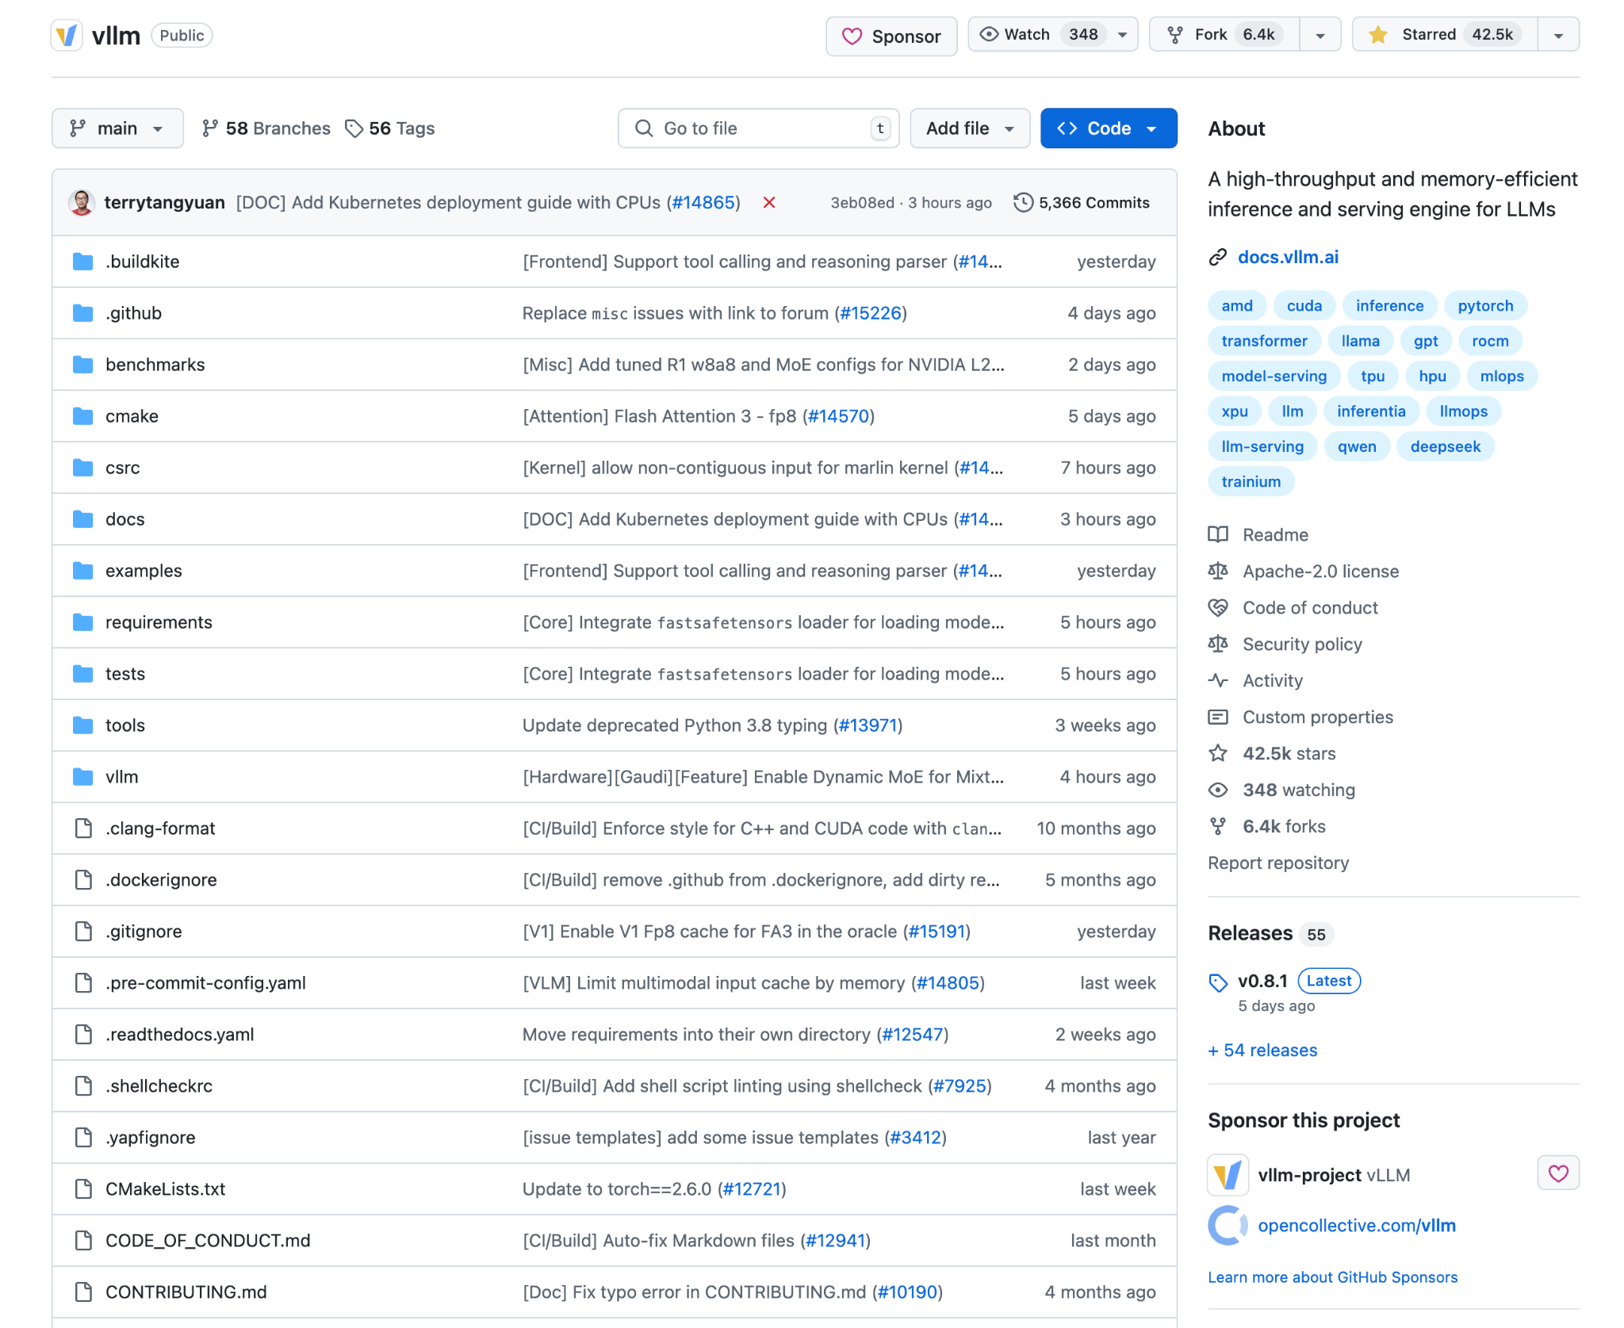
Stars and Forks
Descriptions,
Links,
Keywords
Releases and Versions

Slide 6
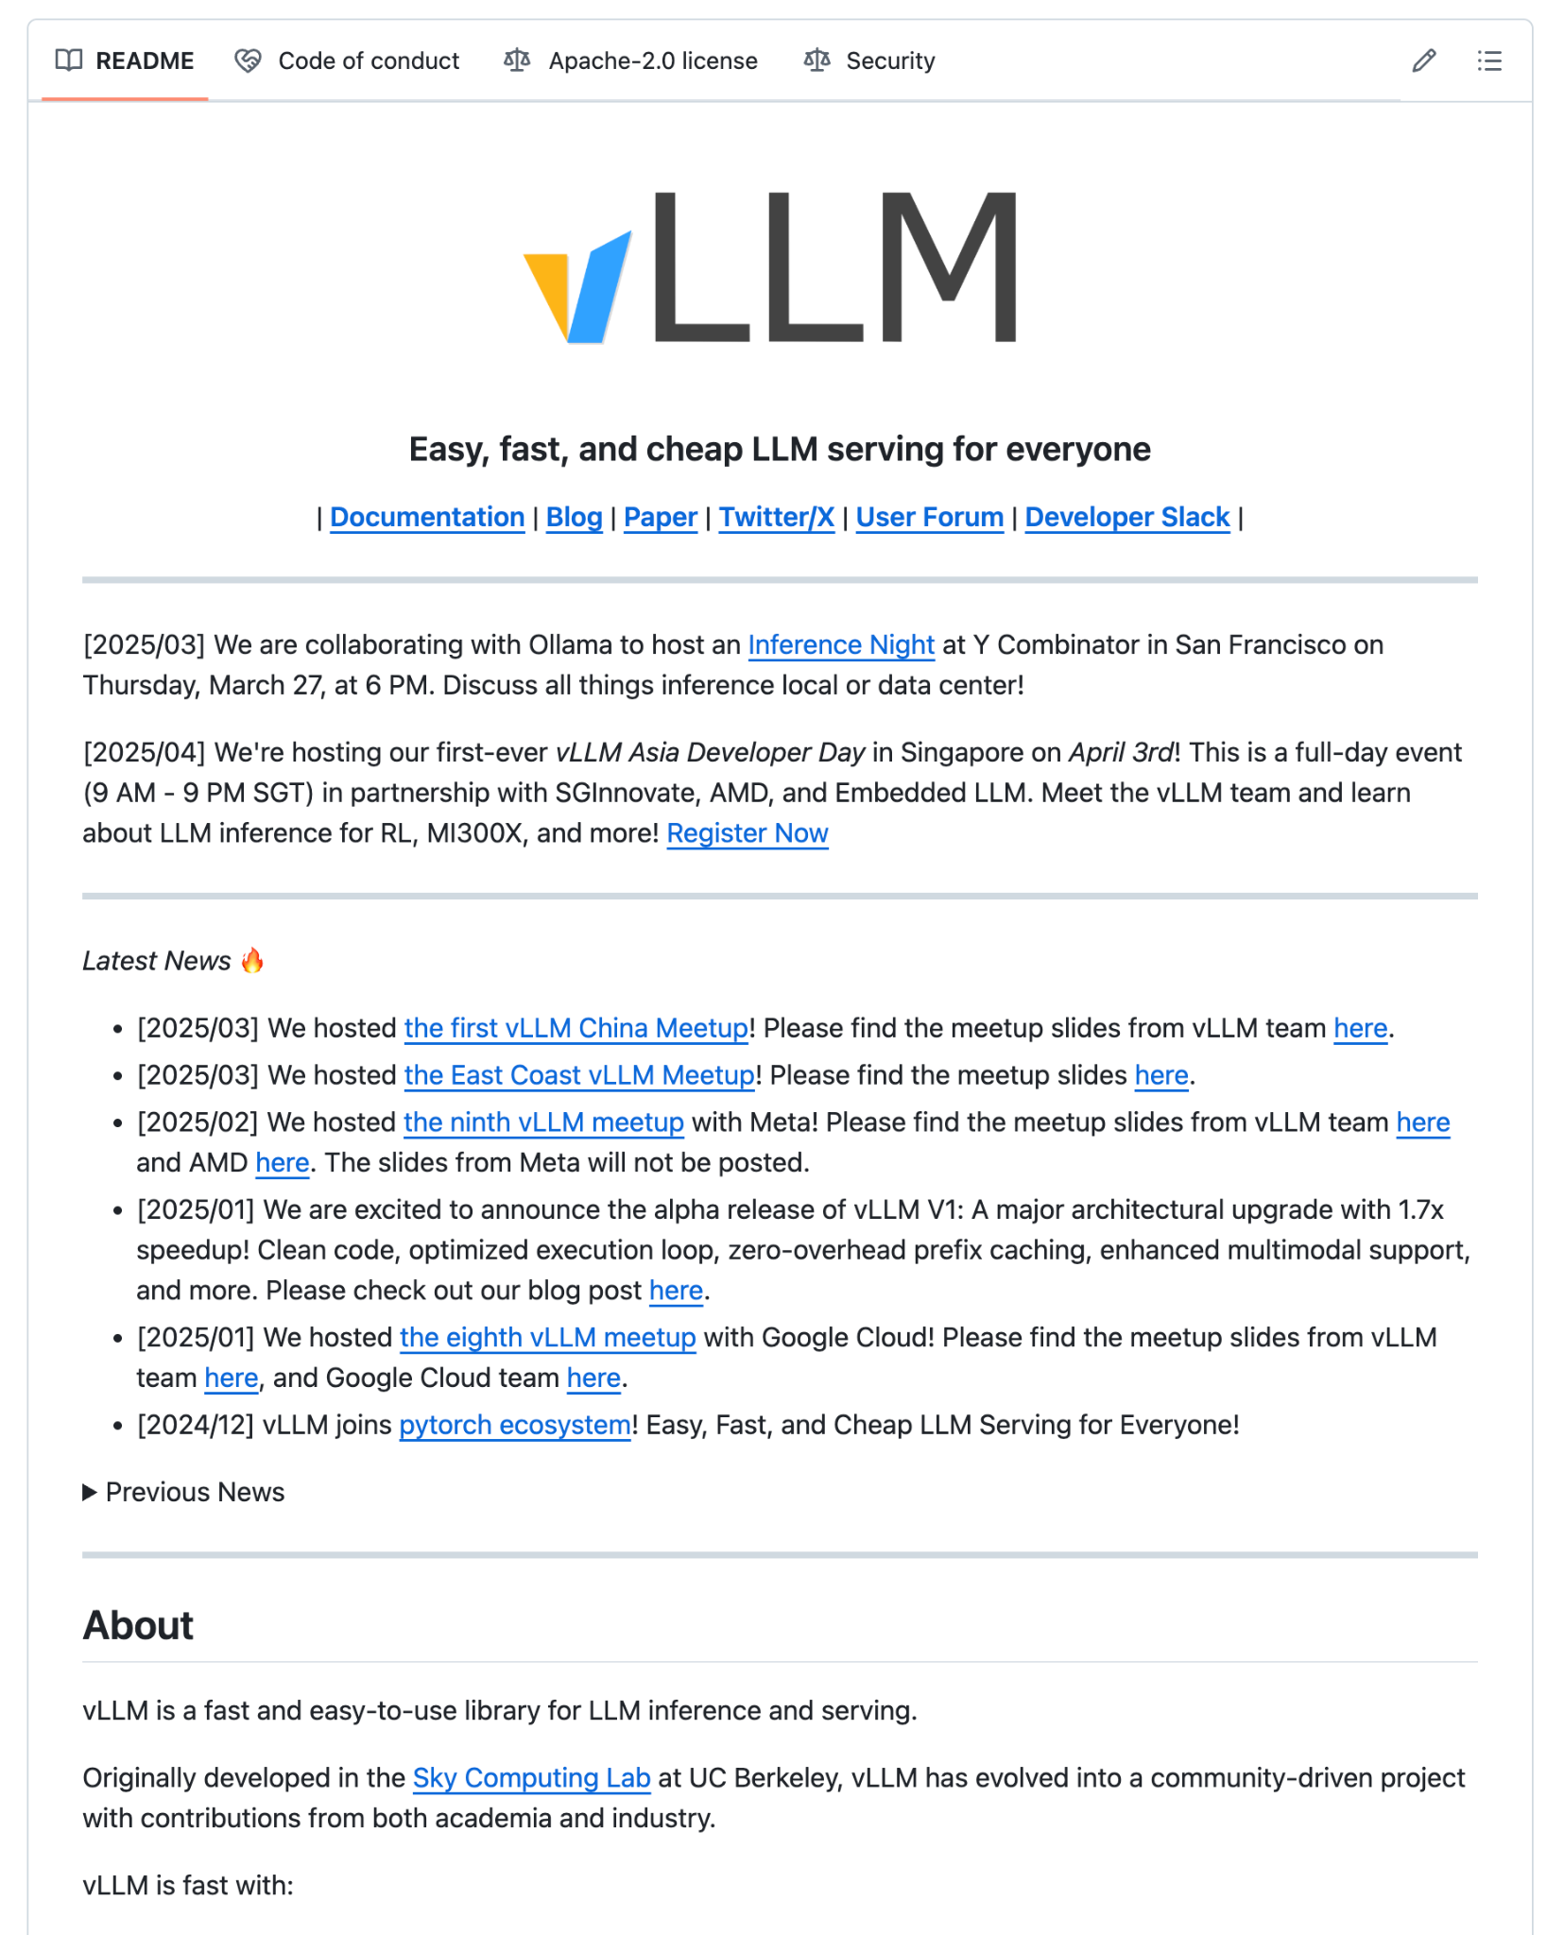
README.MD
Markdown Syntax
Markdown: https://www.markdownguide.org/basic-syntax/

Slide 7
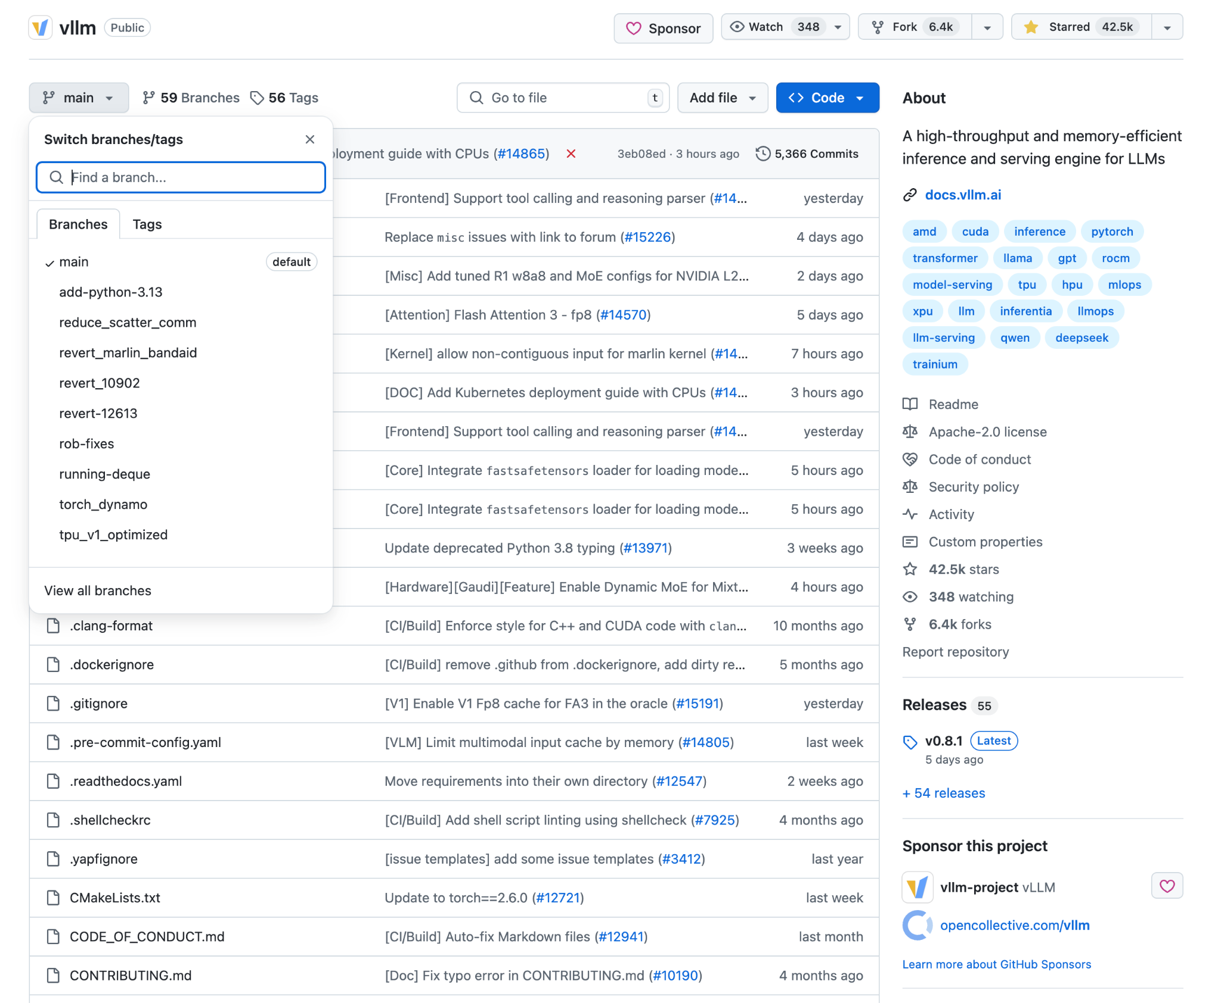
Branches

Slide 8
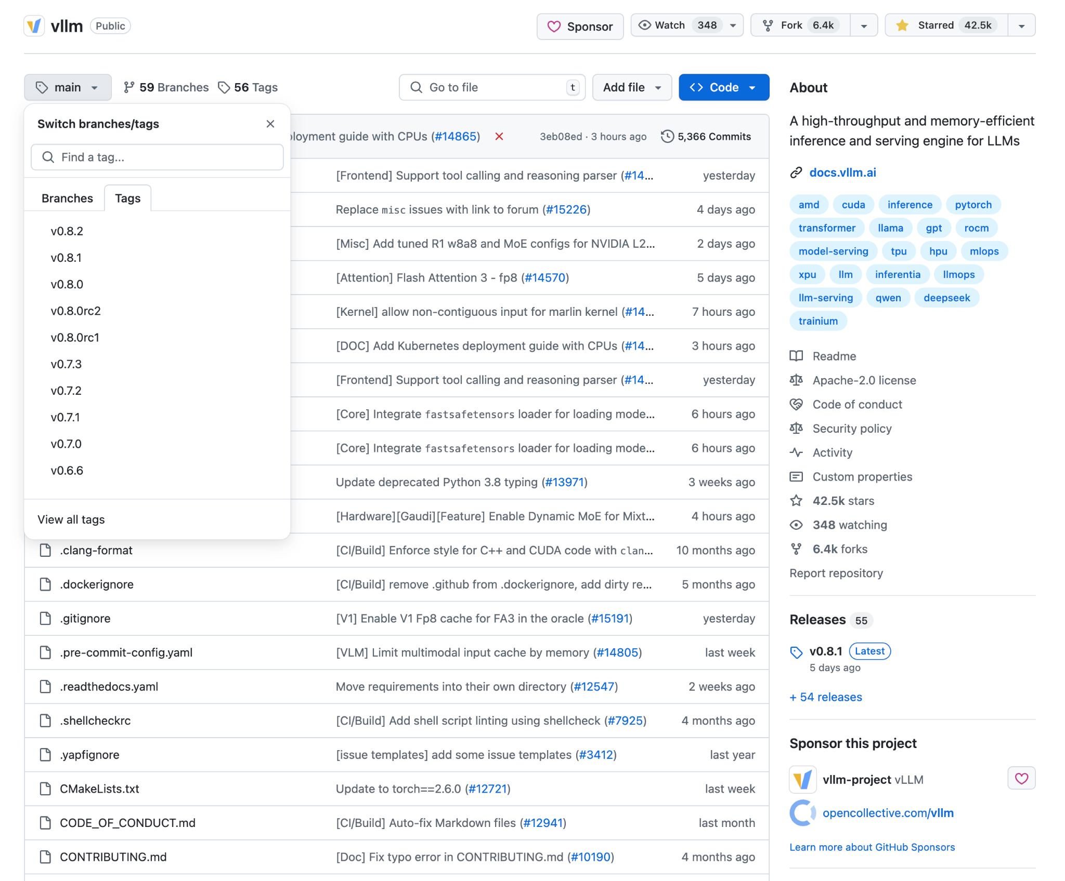
Tags

Slide 9
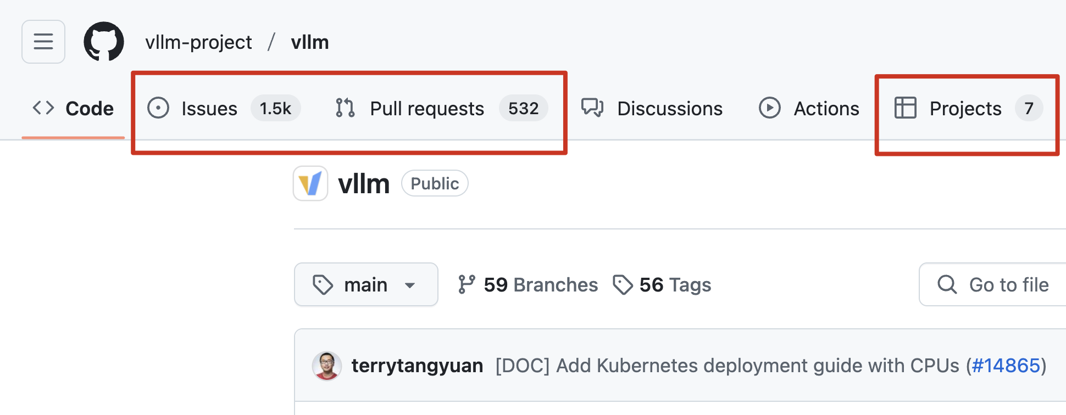
Issues, Pull Requests, Projects

Slide 10
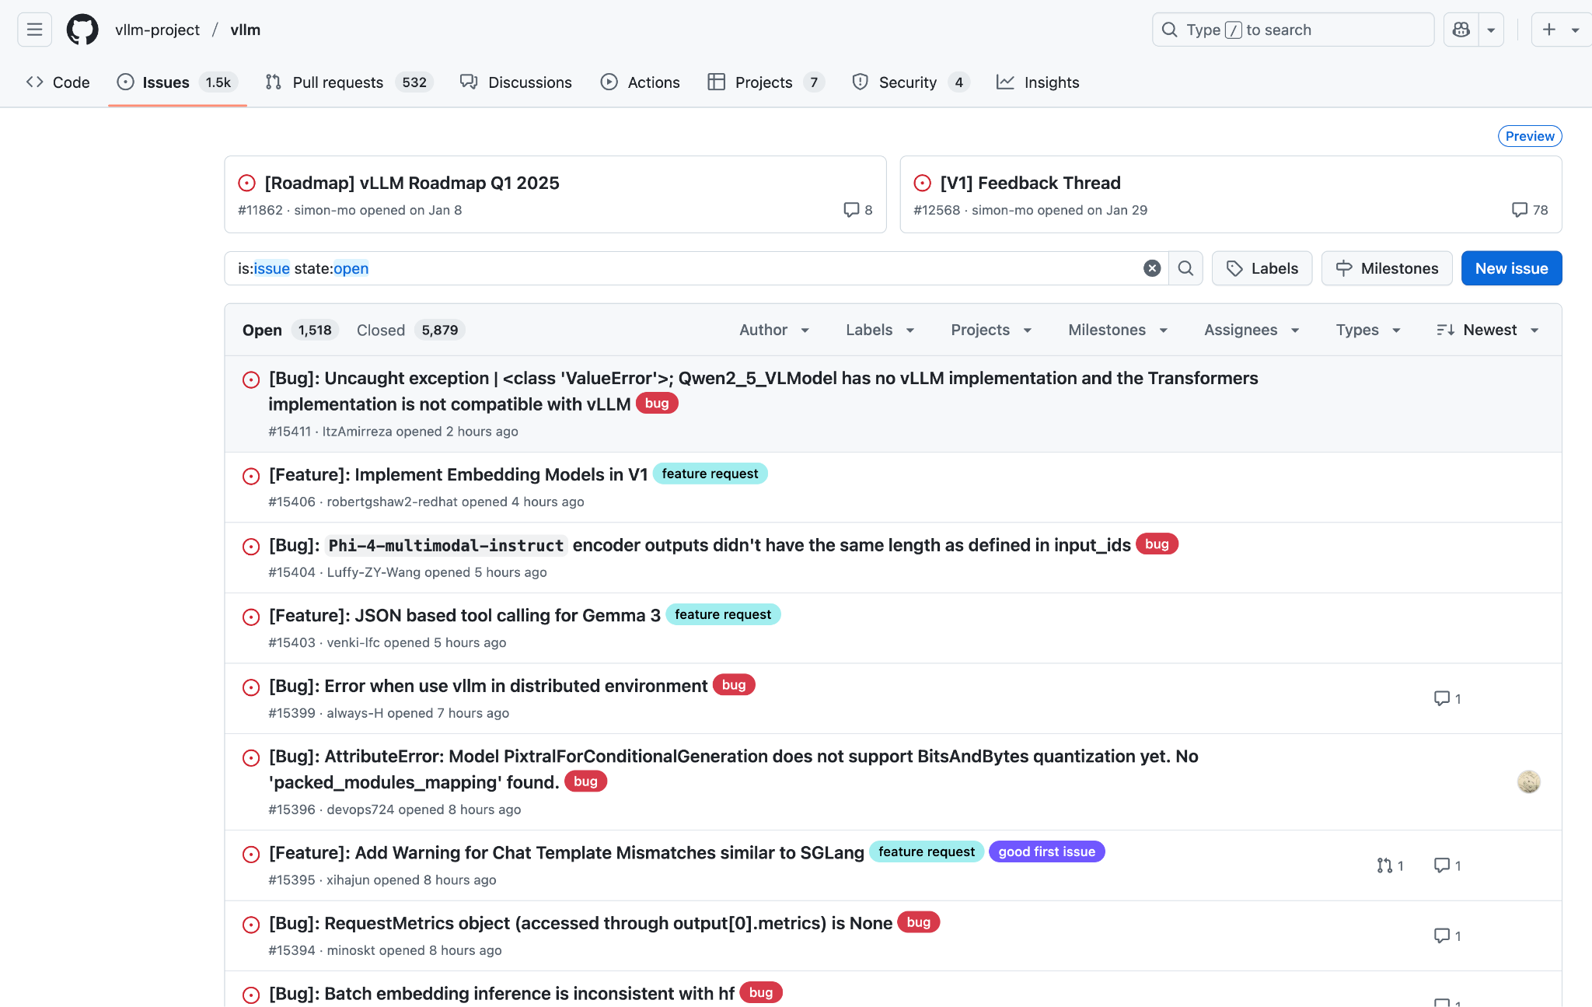
Issues

Slide 11
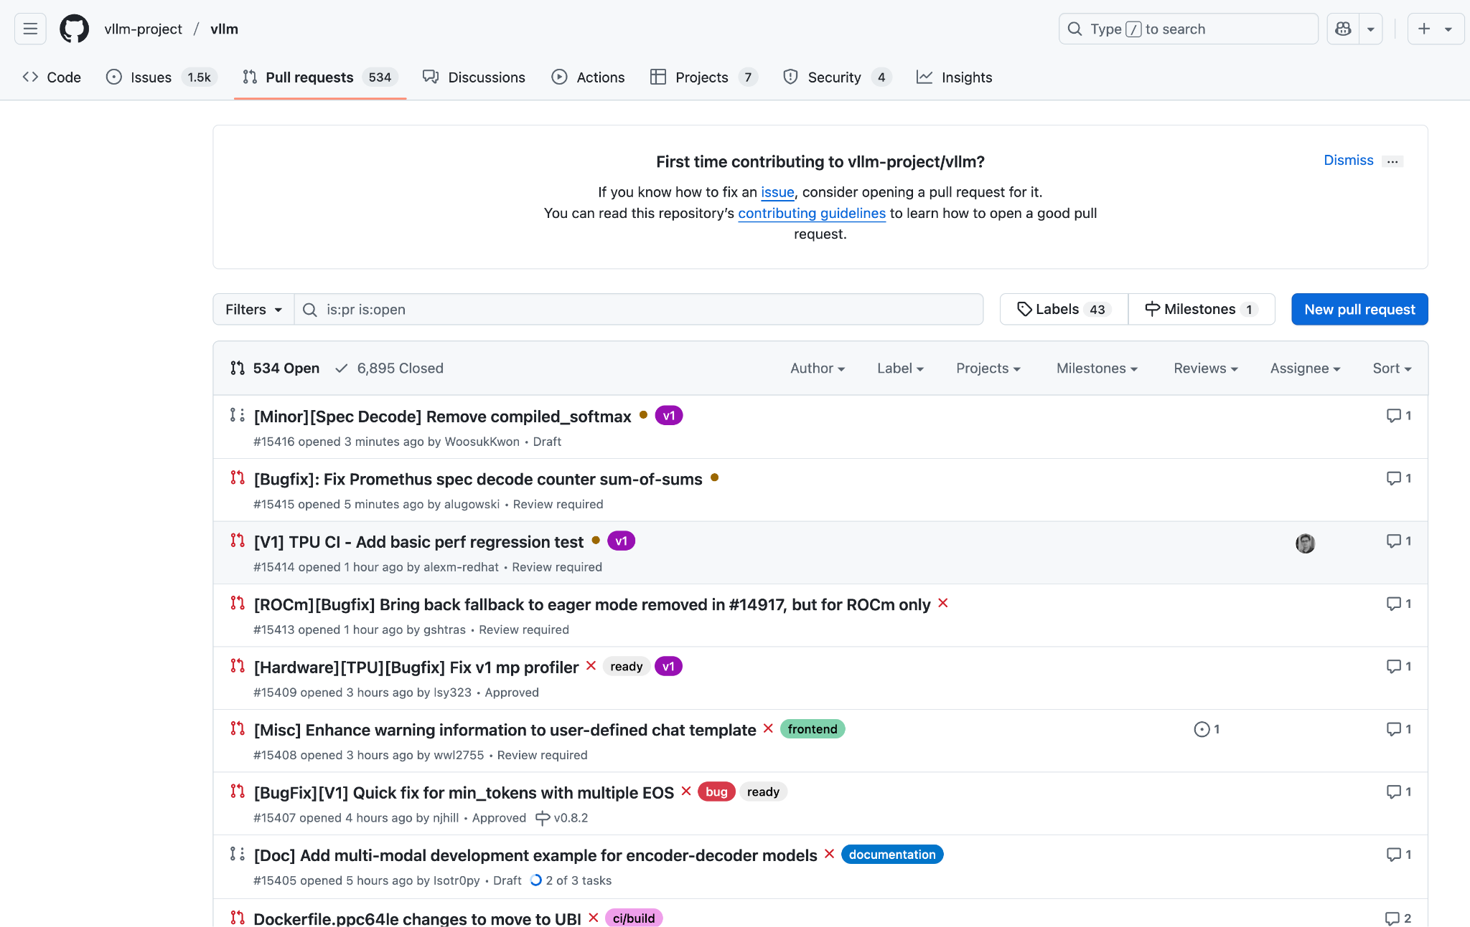
Pull request

Slide 12
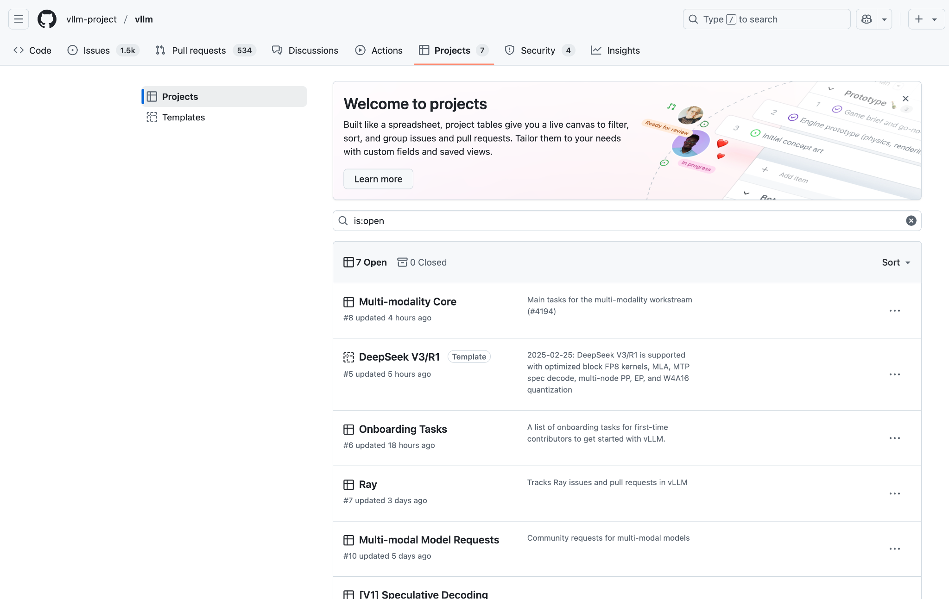
Projects

Slide 13
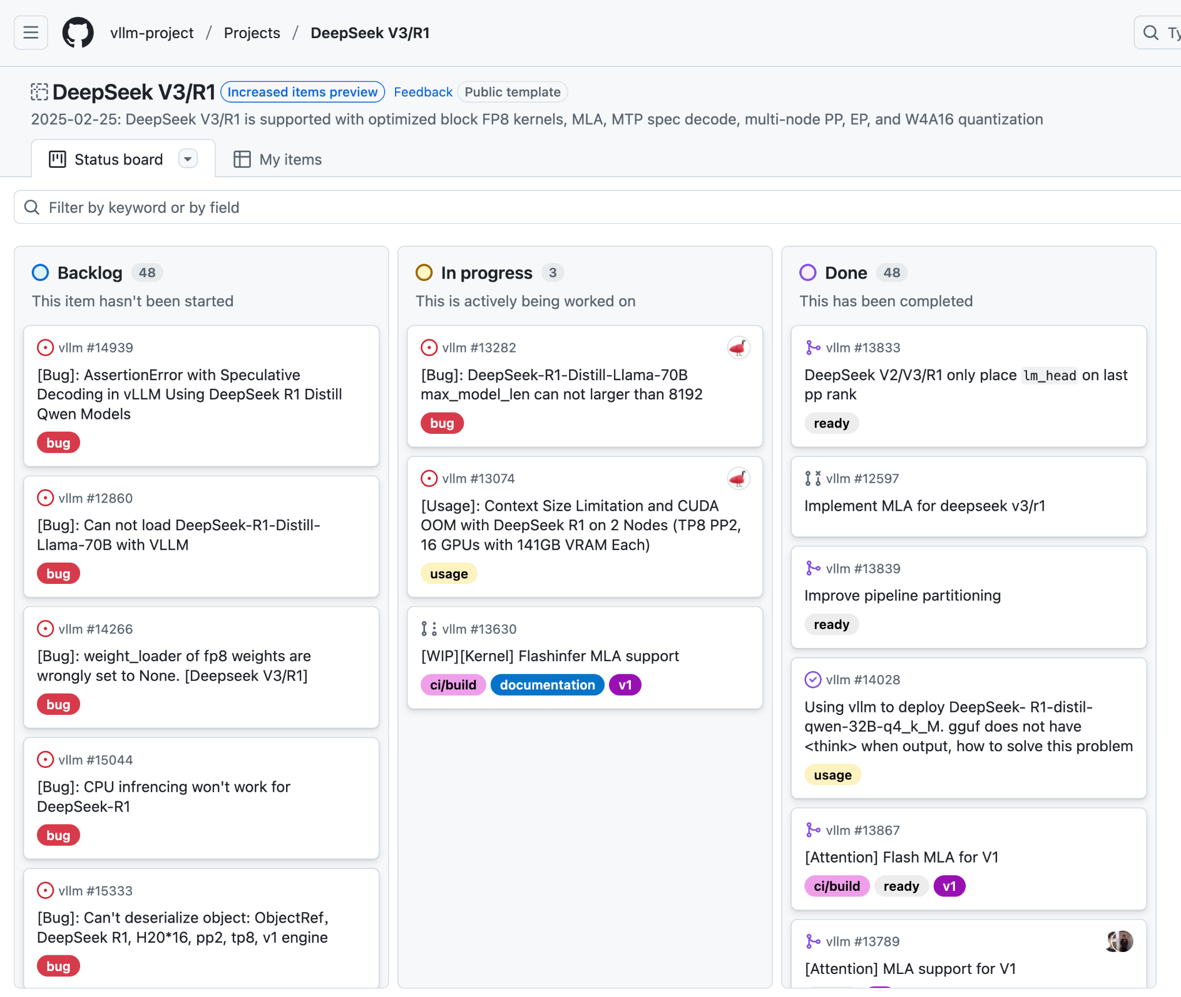
Roadmap/Status board

Slide 14
Outline
Git & GitHub
Basic Git Commands
Pull Requests & Code Review
Branches and Merging
Actions & Automating Tests
README Examples

Slide 15

Part 1 - Git and GitHub
Git
Developer: Linus Torvalds
Initially for Linux projects
Extend to collaborative & open-source projects
Version control system
Tracks changes in files
Multiple branches support
Multiple user support
Codes merging
In 2023, 93% developers use GitHub
Download: https://git-scm.com/downloads
Credit: https://www.britannica.com/technology/GitHub

Slide 16

Part 1 - Git and GitHub
GitHub
Cloud-based platform
GitHub copilot
create, store, manage, and share codes
Create and store your code in a repository
Share your work
Let others review your code and make suggestions
Collaborate on a shared project

Slide 17
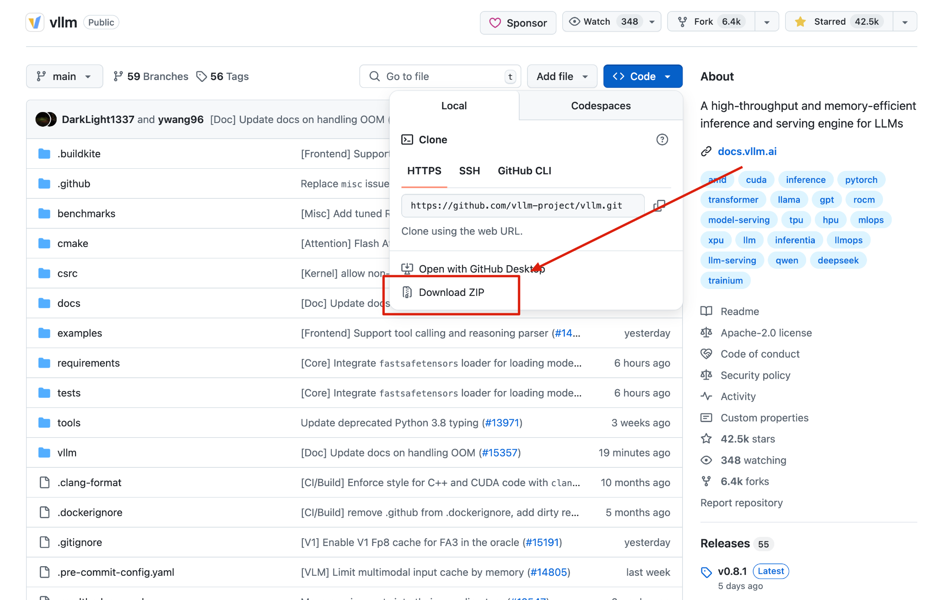
Part 2 - Basic Git Commands
Download Codes (manually)

Slide 18
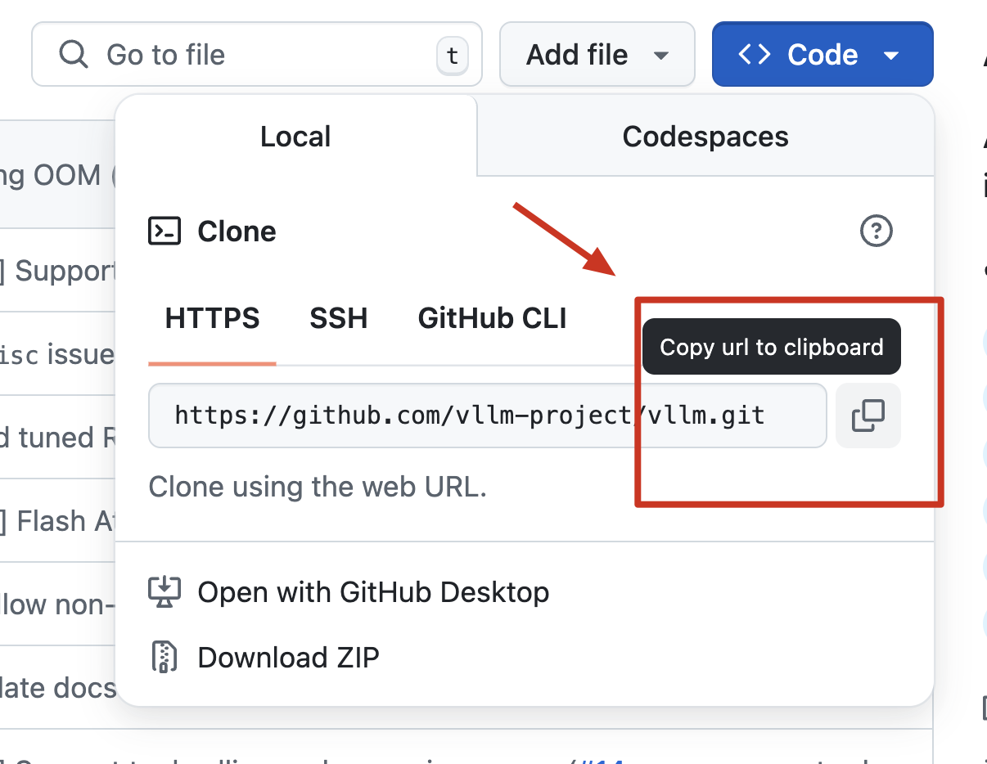
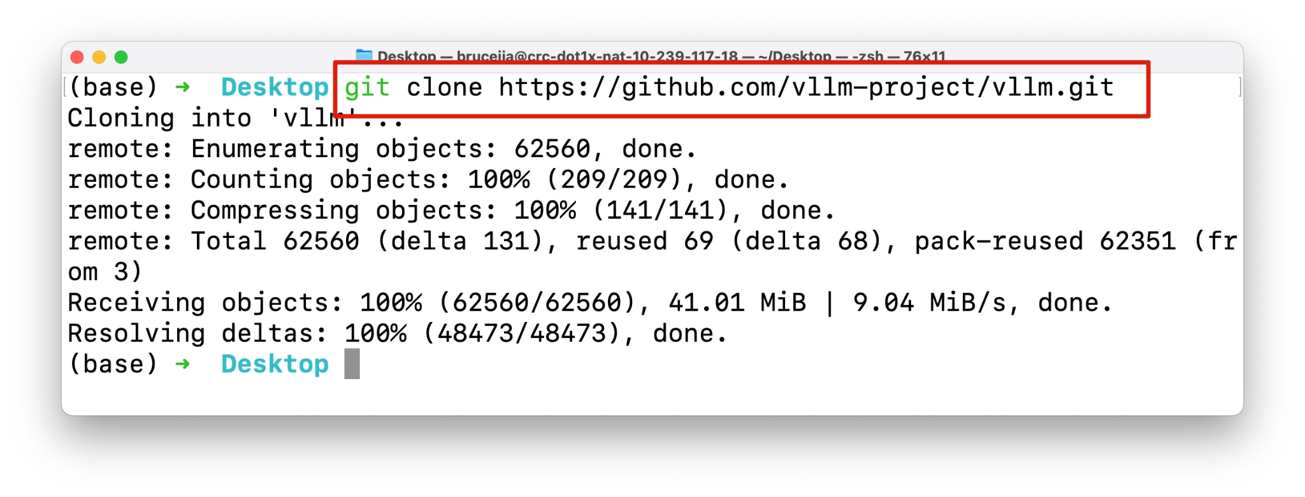
Part 2 - Basic Git Commands
Download Codes
Copy the link of this repo
git clone https://github.com/vllm-project/vllm.git
Step 1: copy the link
Step 2: git clone link

Slide 19
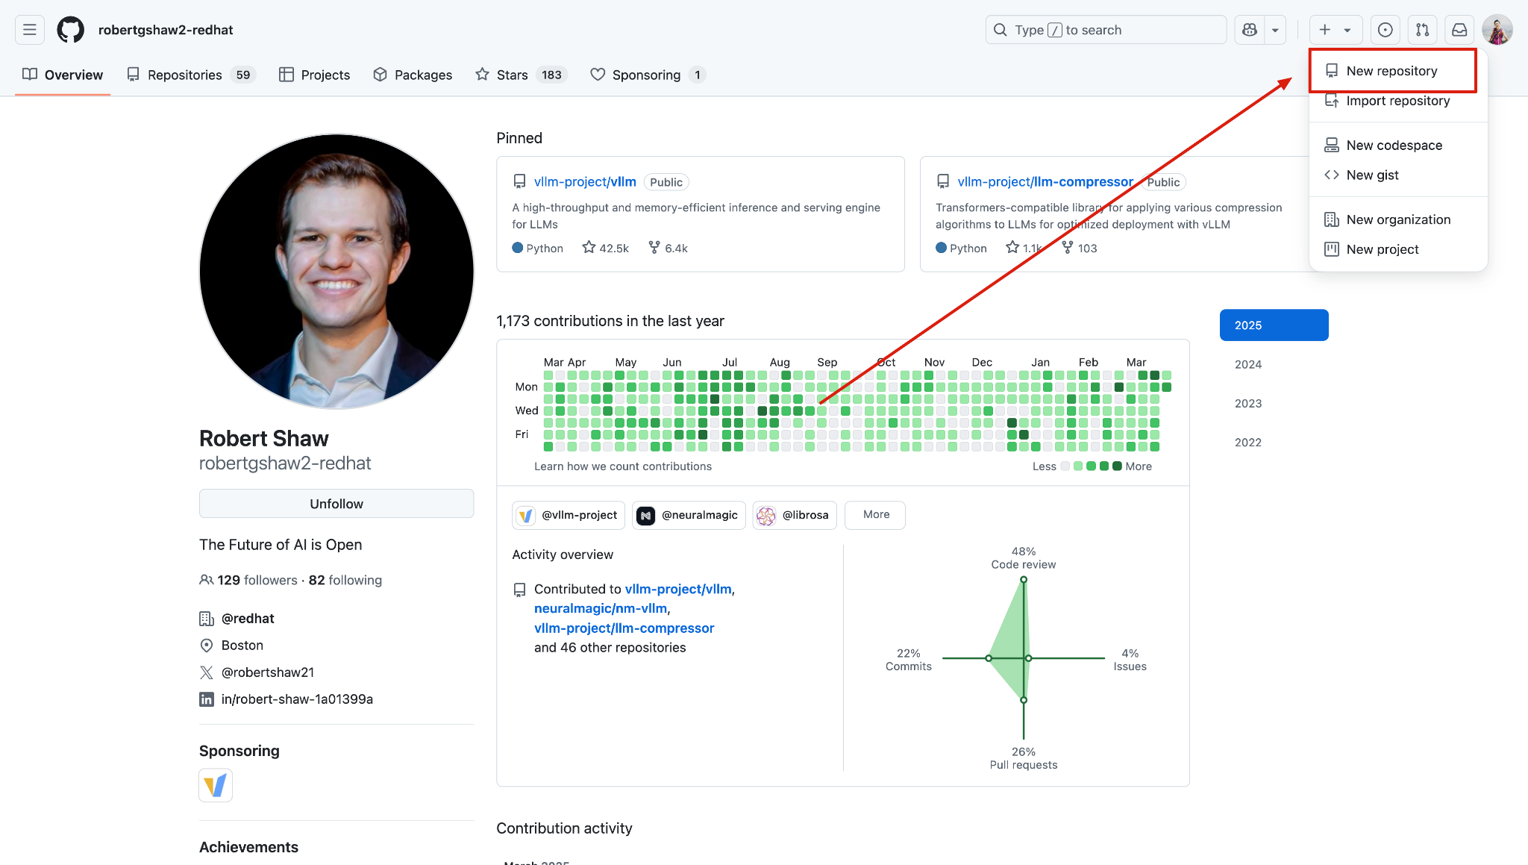
Part 2 - Basic Git Commands
Upload Codes → First create a repo on your profile

Slide 20
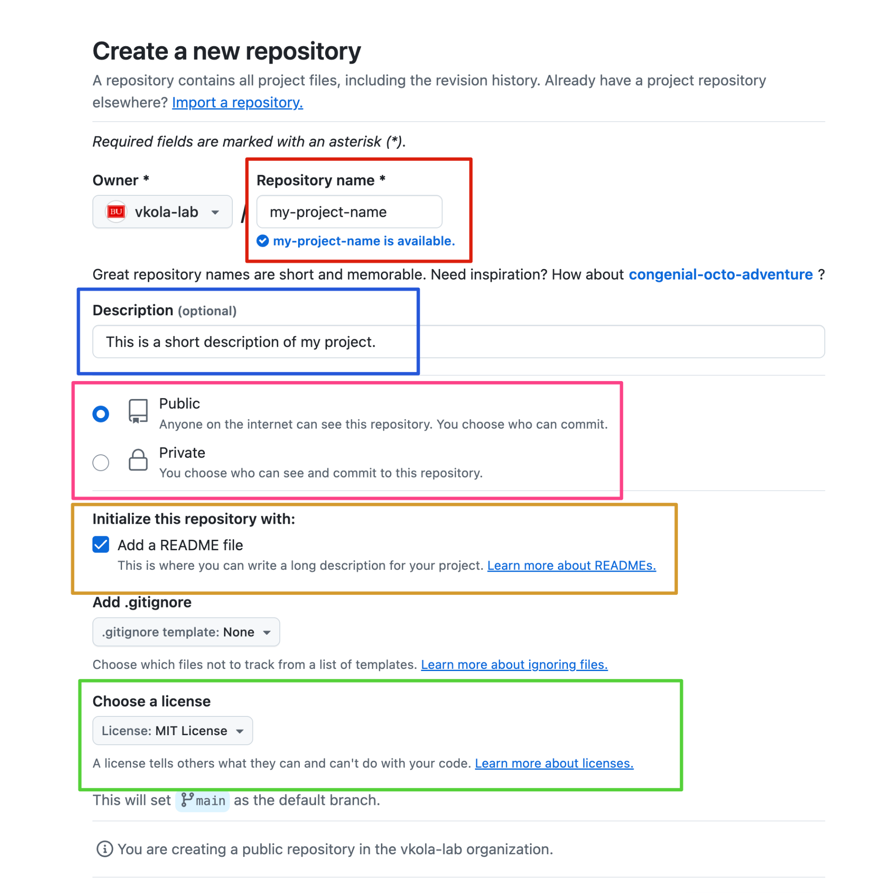
Part 2 - Basic Git Commands
Upload Codes
1: Repo name
2: Description
3: Public/Private
4: README.MD
5: License

Slide 21
Part 2 - Basic Git Commands
Commit and Upload Codes
First way: drag and drop the code files
Second way: terminal
Add the codes in the current folder to git
git add .
Commit the codes
git commit -m "Update my lovely codes!"
Push the codes
git push

Slide 22
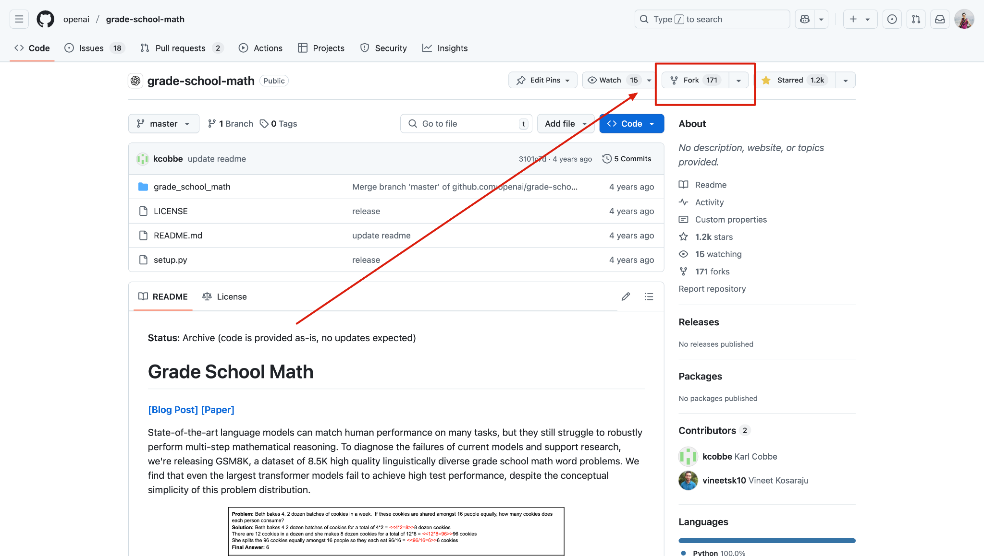
Part 3 - Pull Requests & Code Review
Fork the Codes if you haven't made the changes

Slide 23
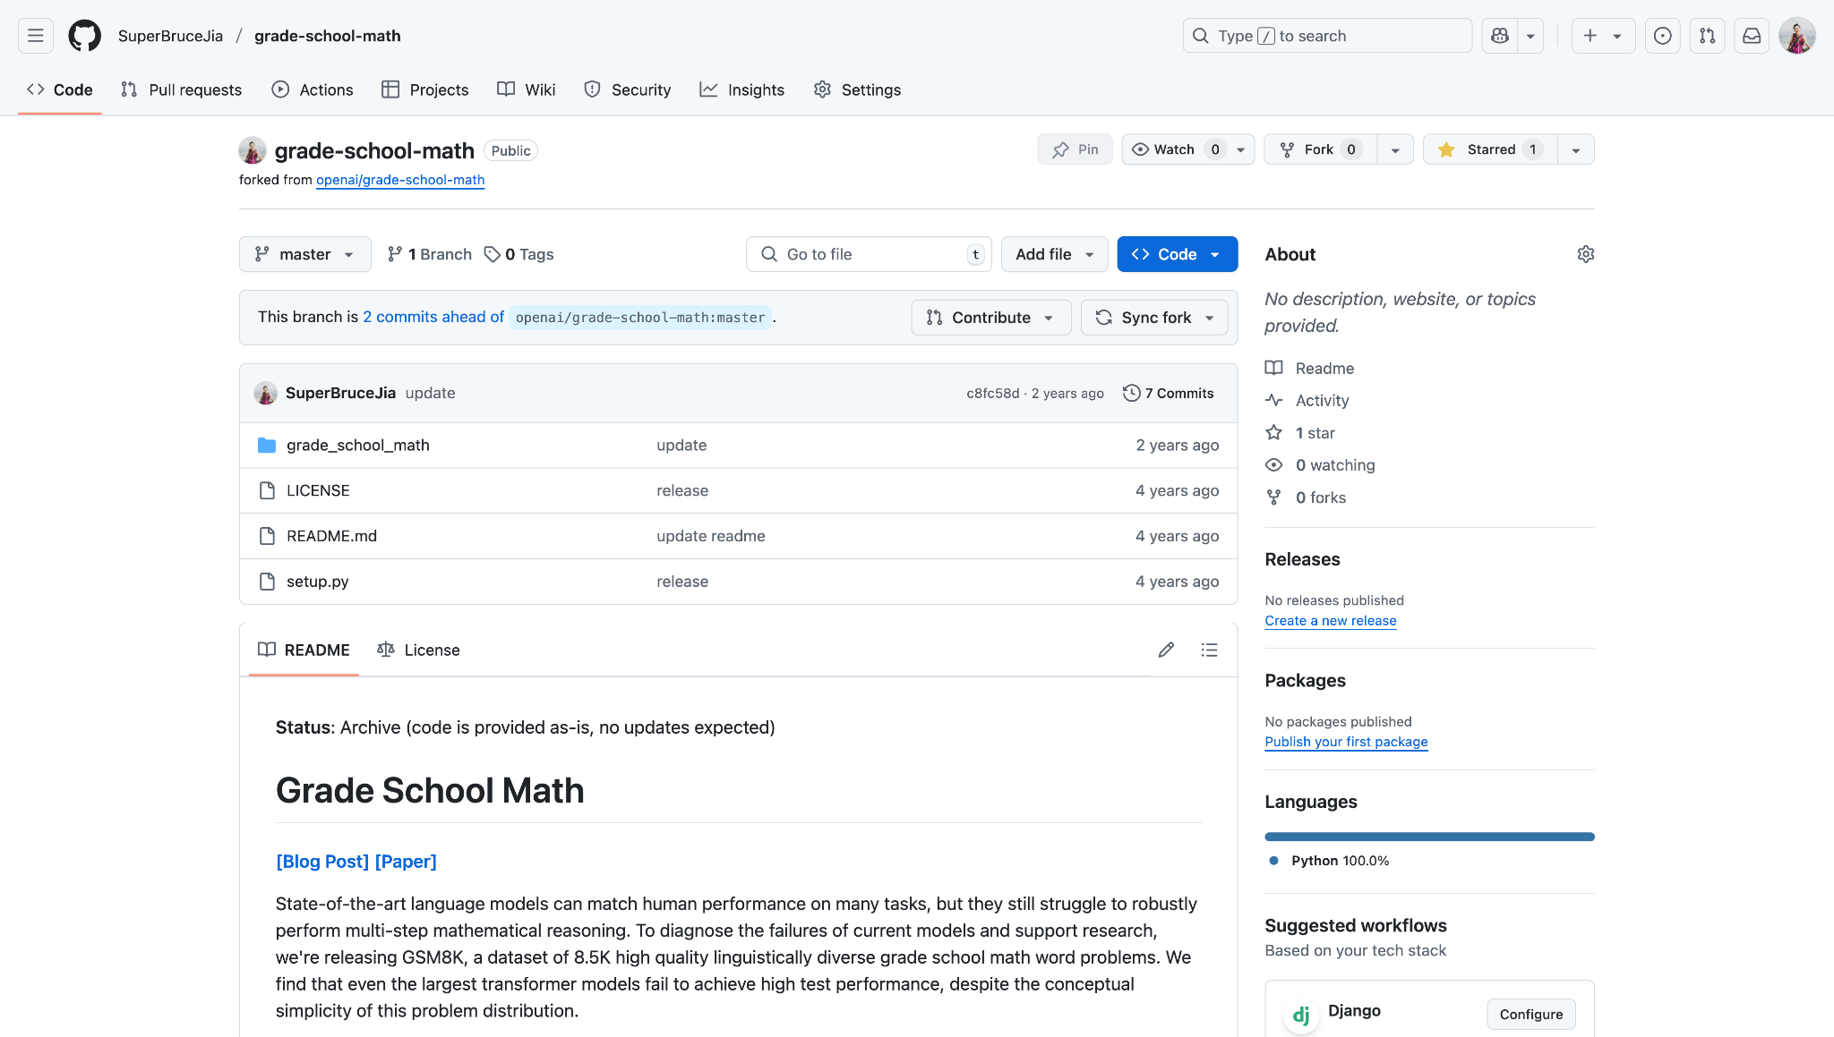
Part 3 - Pull Requests & Code Review
Fork the Codes if you haven't made the changes

Slide 24
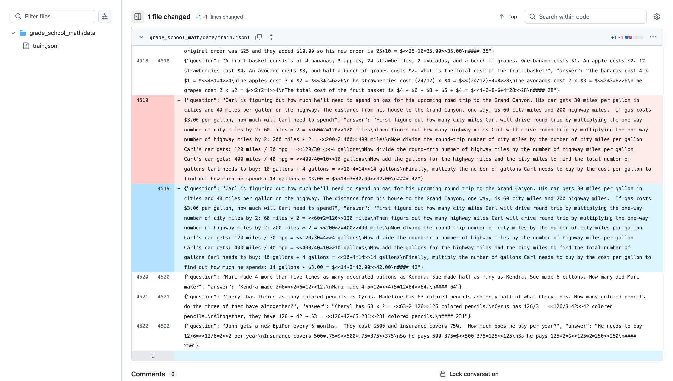
Part 3 - Pull Requests & Code Review
Make any changes to the codes → Commit

Slide 25
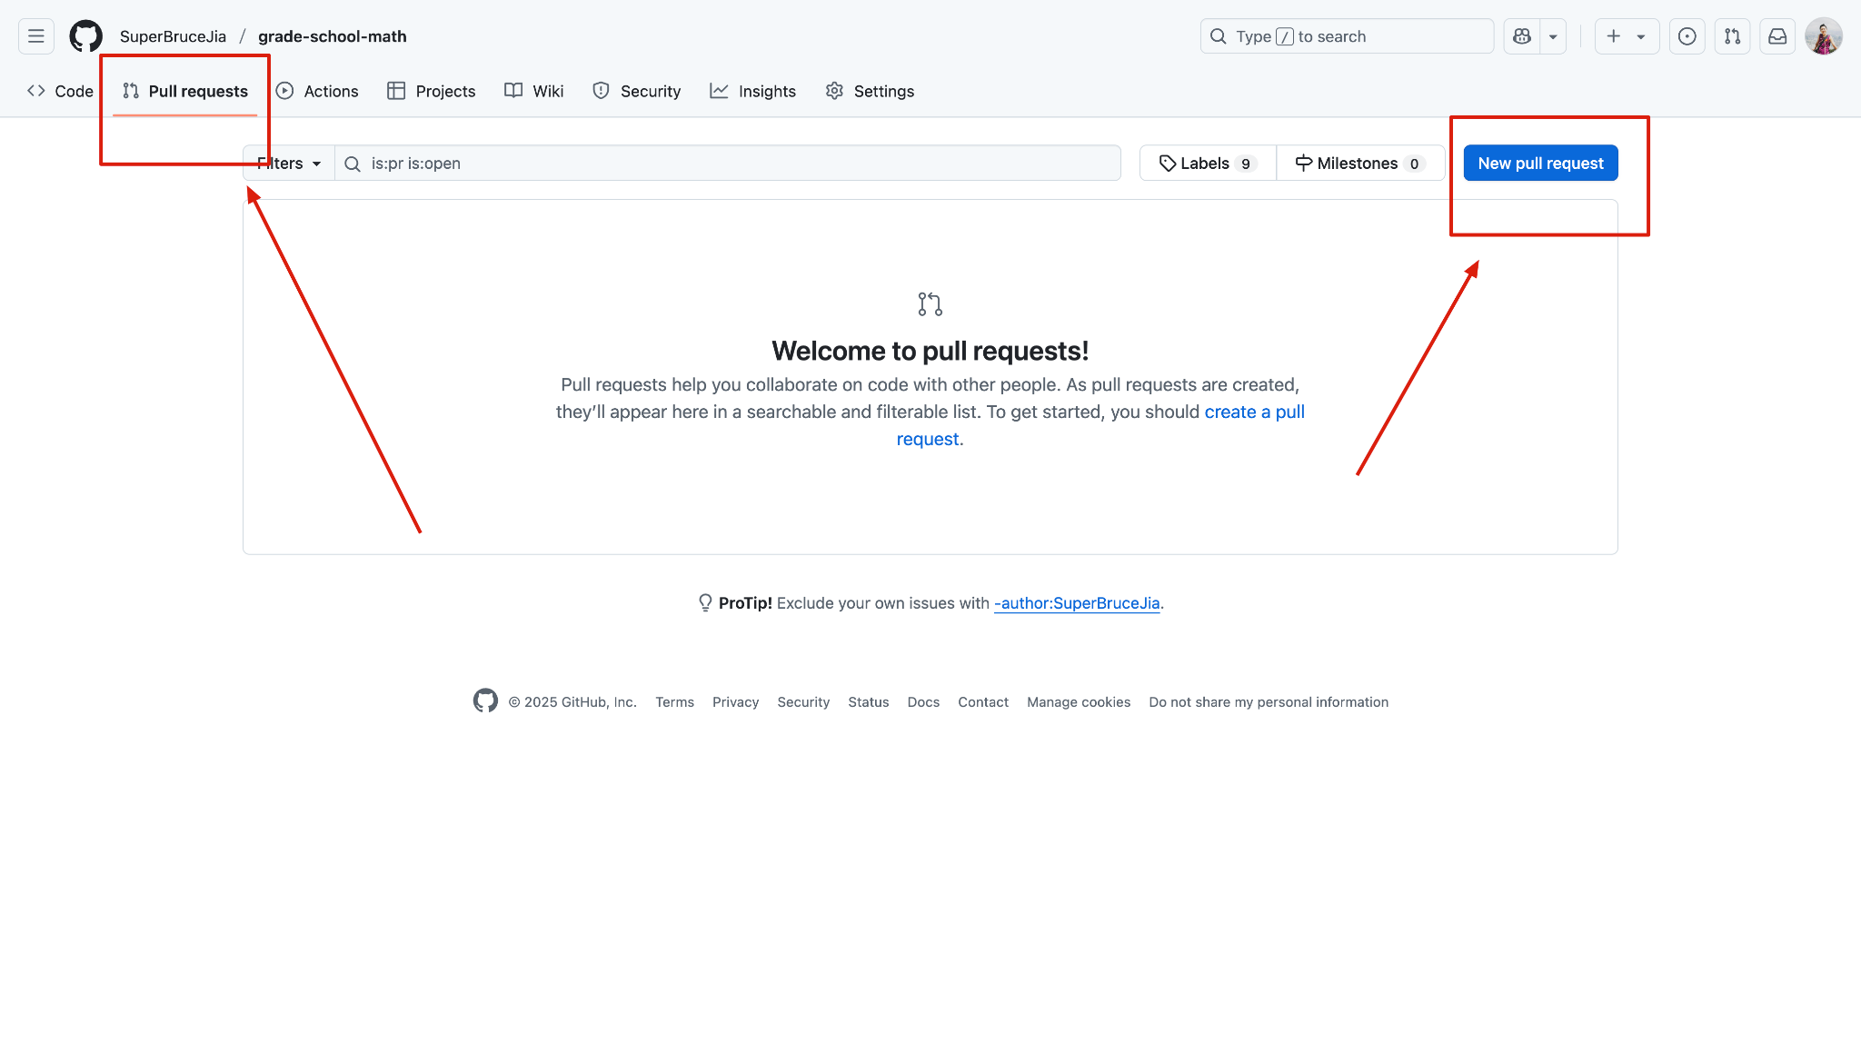
Part 3 - Pull Requests & Code Review
New pull request

Slide 26
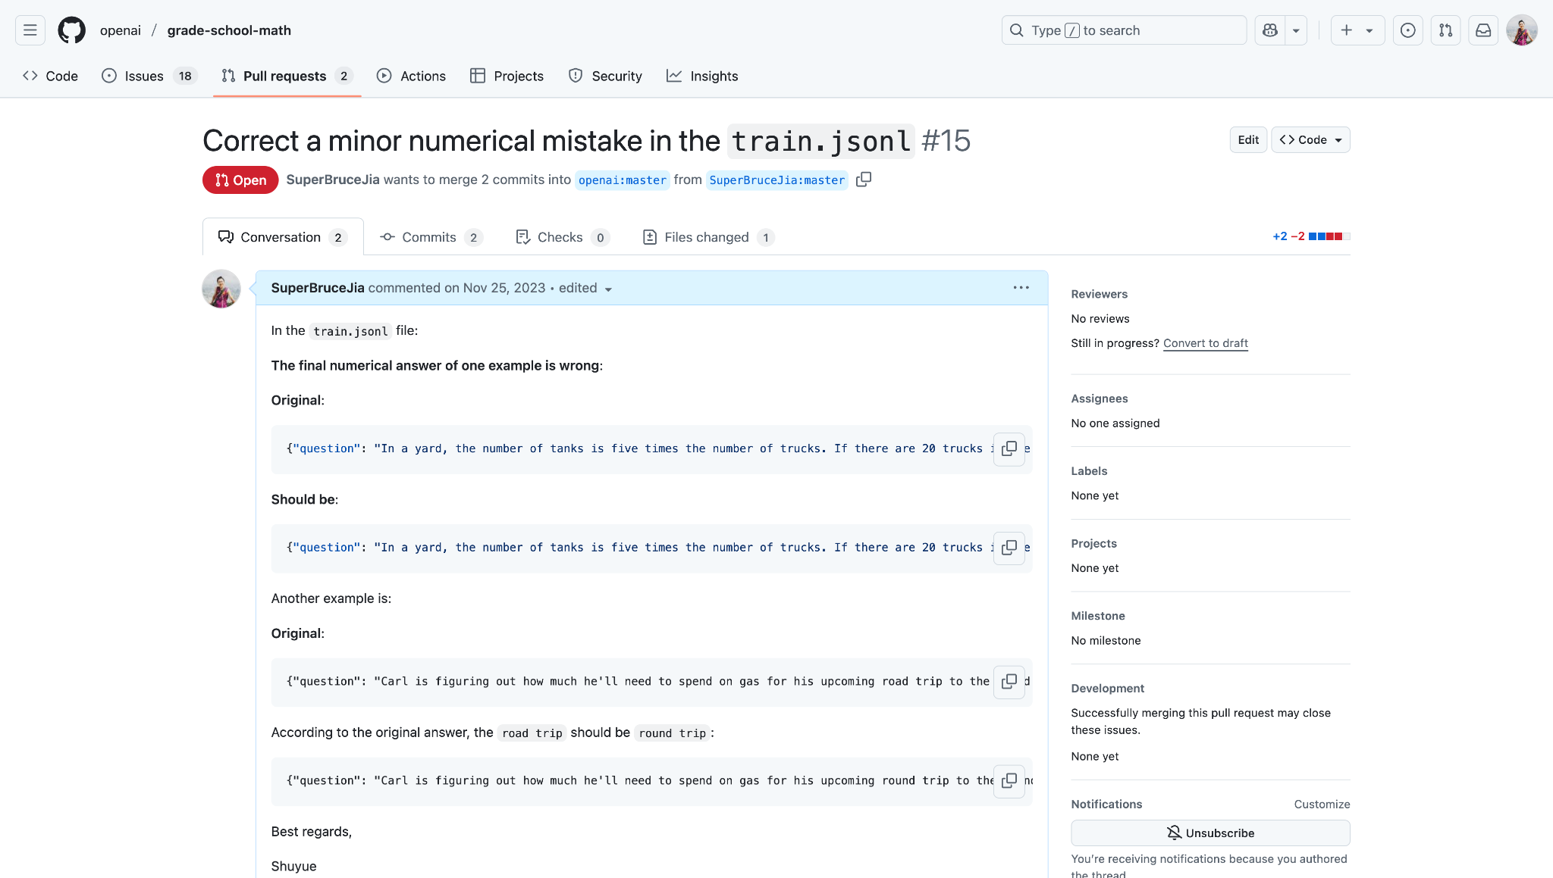
Part 3 - Pull Requests & Code Review
New pull request → Code review & Comment → Merge

Slide 27
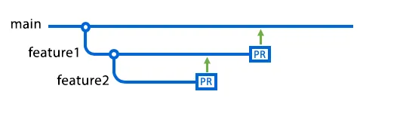
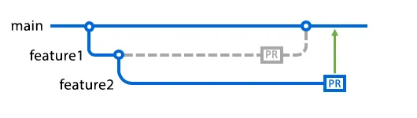
Part 4 - Branches & Merging
Potential conflict issue
1: main branch
2: feature 1 branch
3: feature 2 branch
Credit: https://docs.github.com/en/pull-requests/collaborating-with-pull-requests/proposing-changes-to-your-work-with-pull-requests/about-branches

Slide 28
Part 4 - Branches & Merging
Create a new branch and Upload Codes
Create a new branch called new-feature
git checkout -b new-feature
Add changes to your new branch
git add .
Commit your changes
git commit -m "Change method in lovely file."
Push your branch to a remote
git push -u origin new-feature
Credit: https://graphite.dev/guides/git-commit-to-new-branch

Slide 29
Part 4 - Branches & Merging
If you have made changes in new-feature branch
Merge codes to the main branch
git checkout main
Add new-feature branch changes to main branch
git merge new-feature
Delete new-feature branch if you don’t need it
git branch -d new-feature
Credit: https://www.w3schools.com/git/git_branch_merge.asp

Slide 30
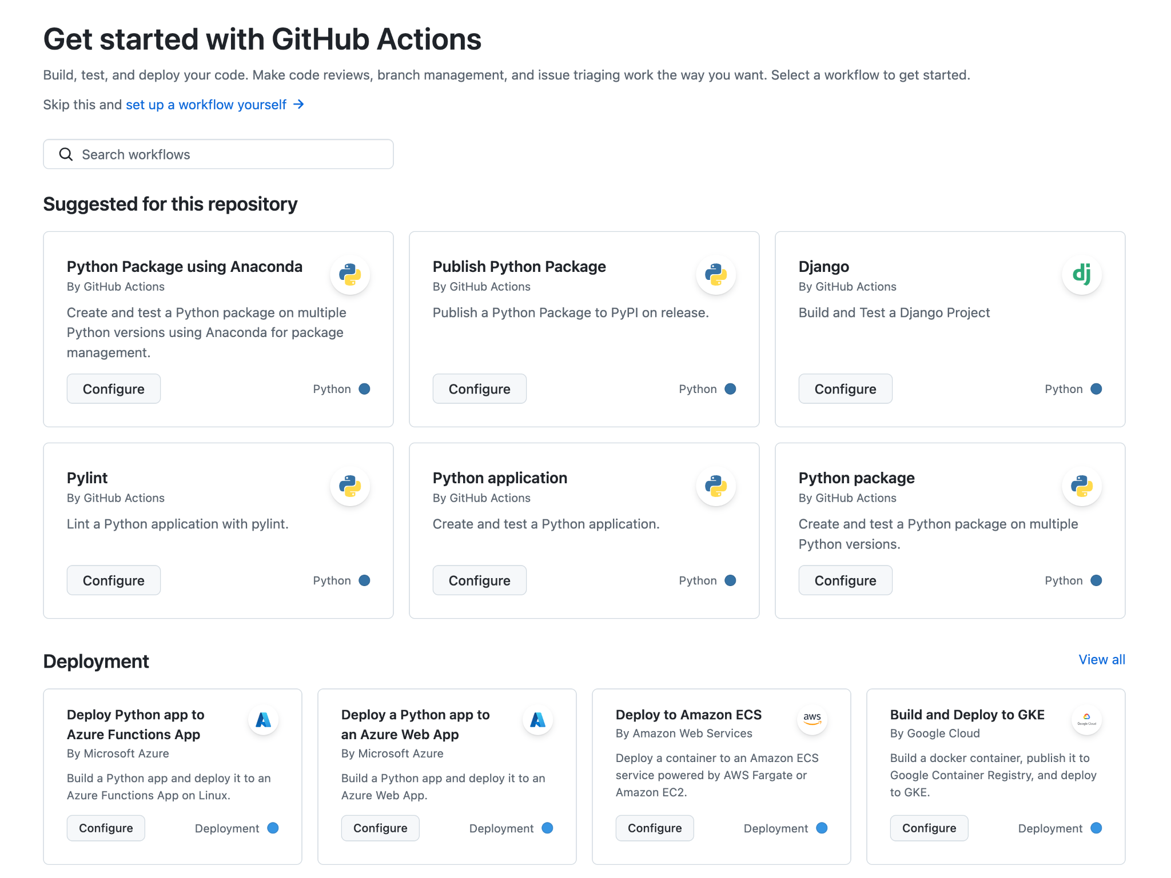
Part 5 - Actions and Automating Tests

Slide 31
Part 5 - Actions and Automating Tests
Continuous integration and continuous delivery (CI/CD)
Automate your build, test, and deployment pipeline
Workflow .github/workflows/github-actions-demo.yml
Name
Jobs
Steps
Actions/Runs
Deploy your homepage using GitHub Action (GitHub Page)
https://pages.github.com
Credit: https://docs.github.com/en/actions/writing-workflows/quickstart

Slide 32
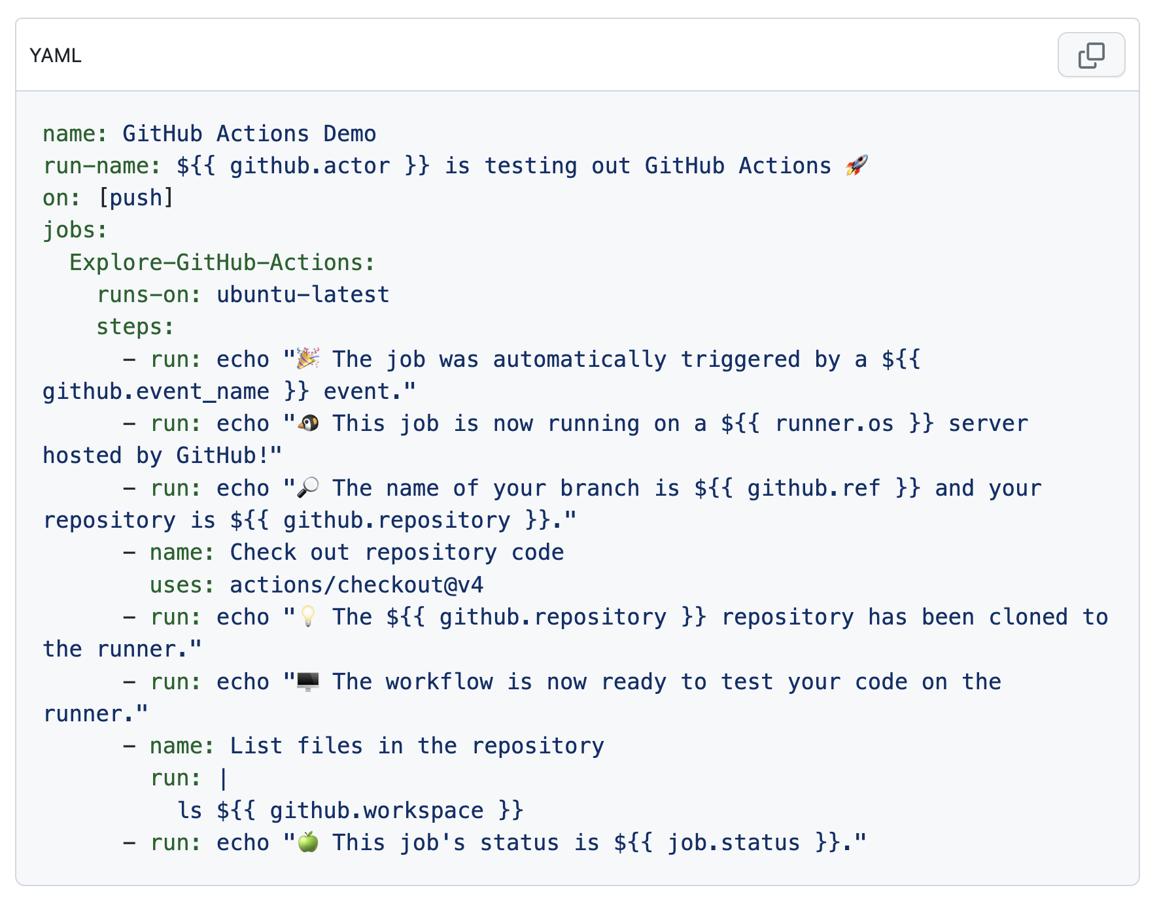
Part 5 - Actions and Automating Tests
Credit: https://docs.github.com/en/actions/writing-workflows/quickstart

Slide 33
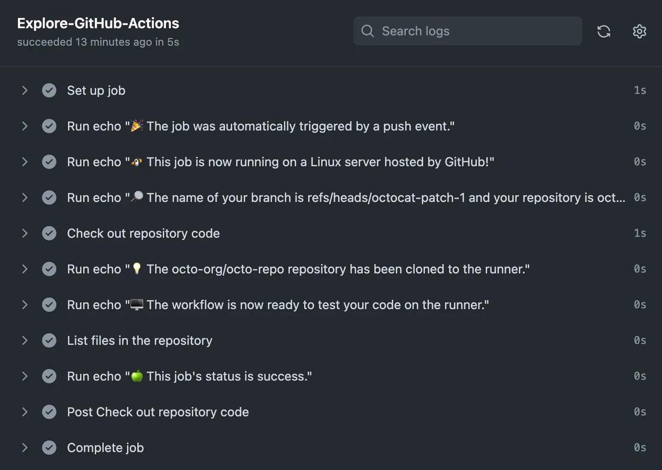
Part 5 - Actions and Automating Tests
Credit: https://docs.github.com/en/actions/writing-workflows/quickstart

Slide 34
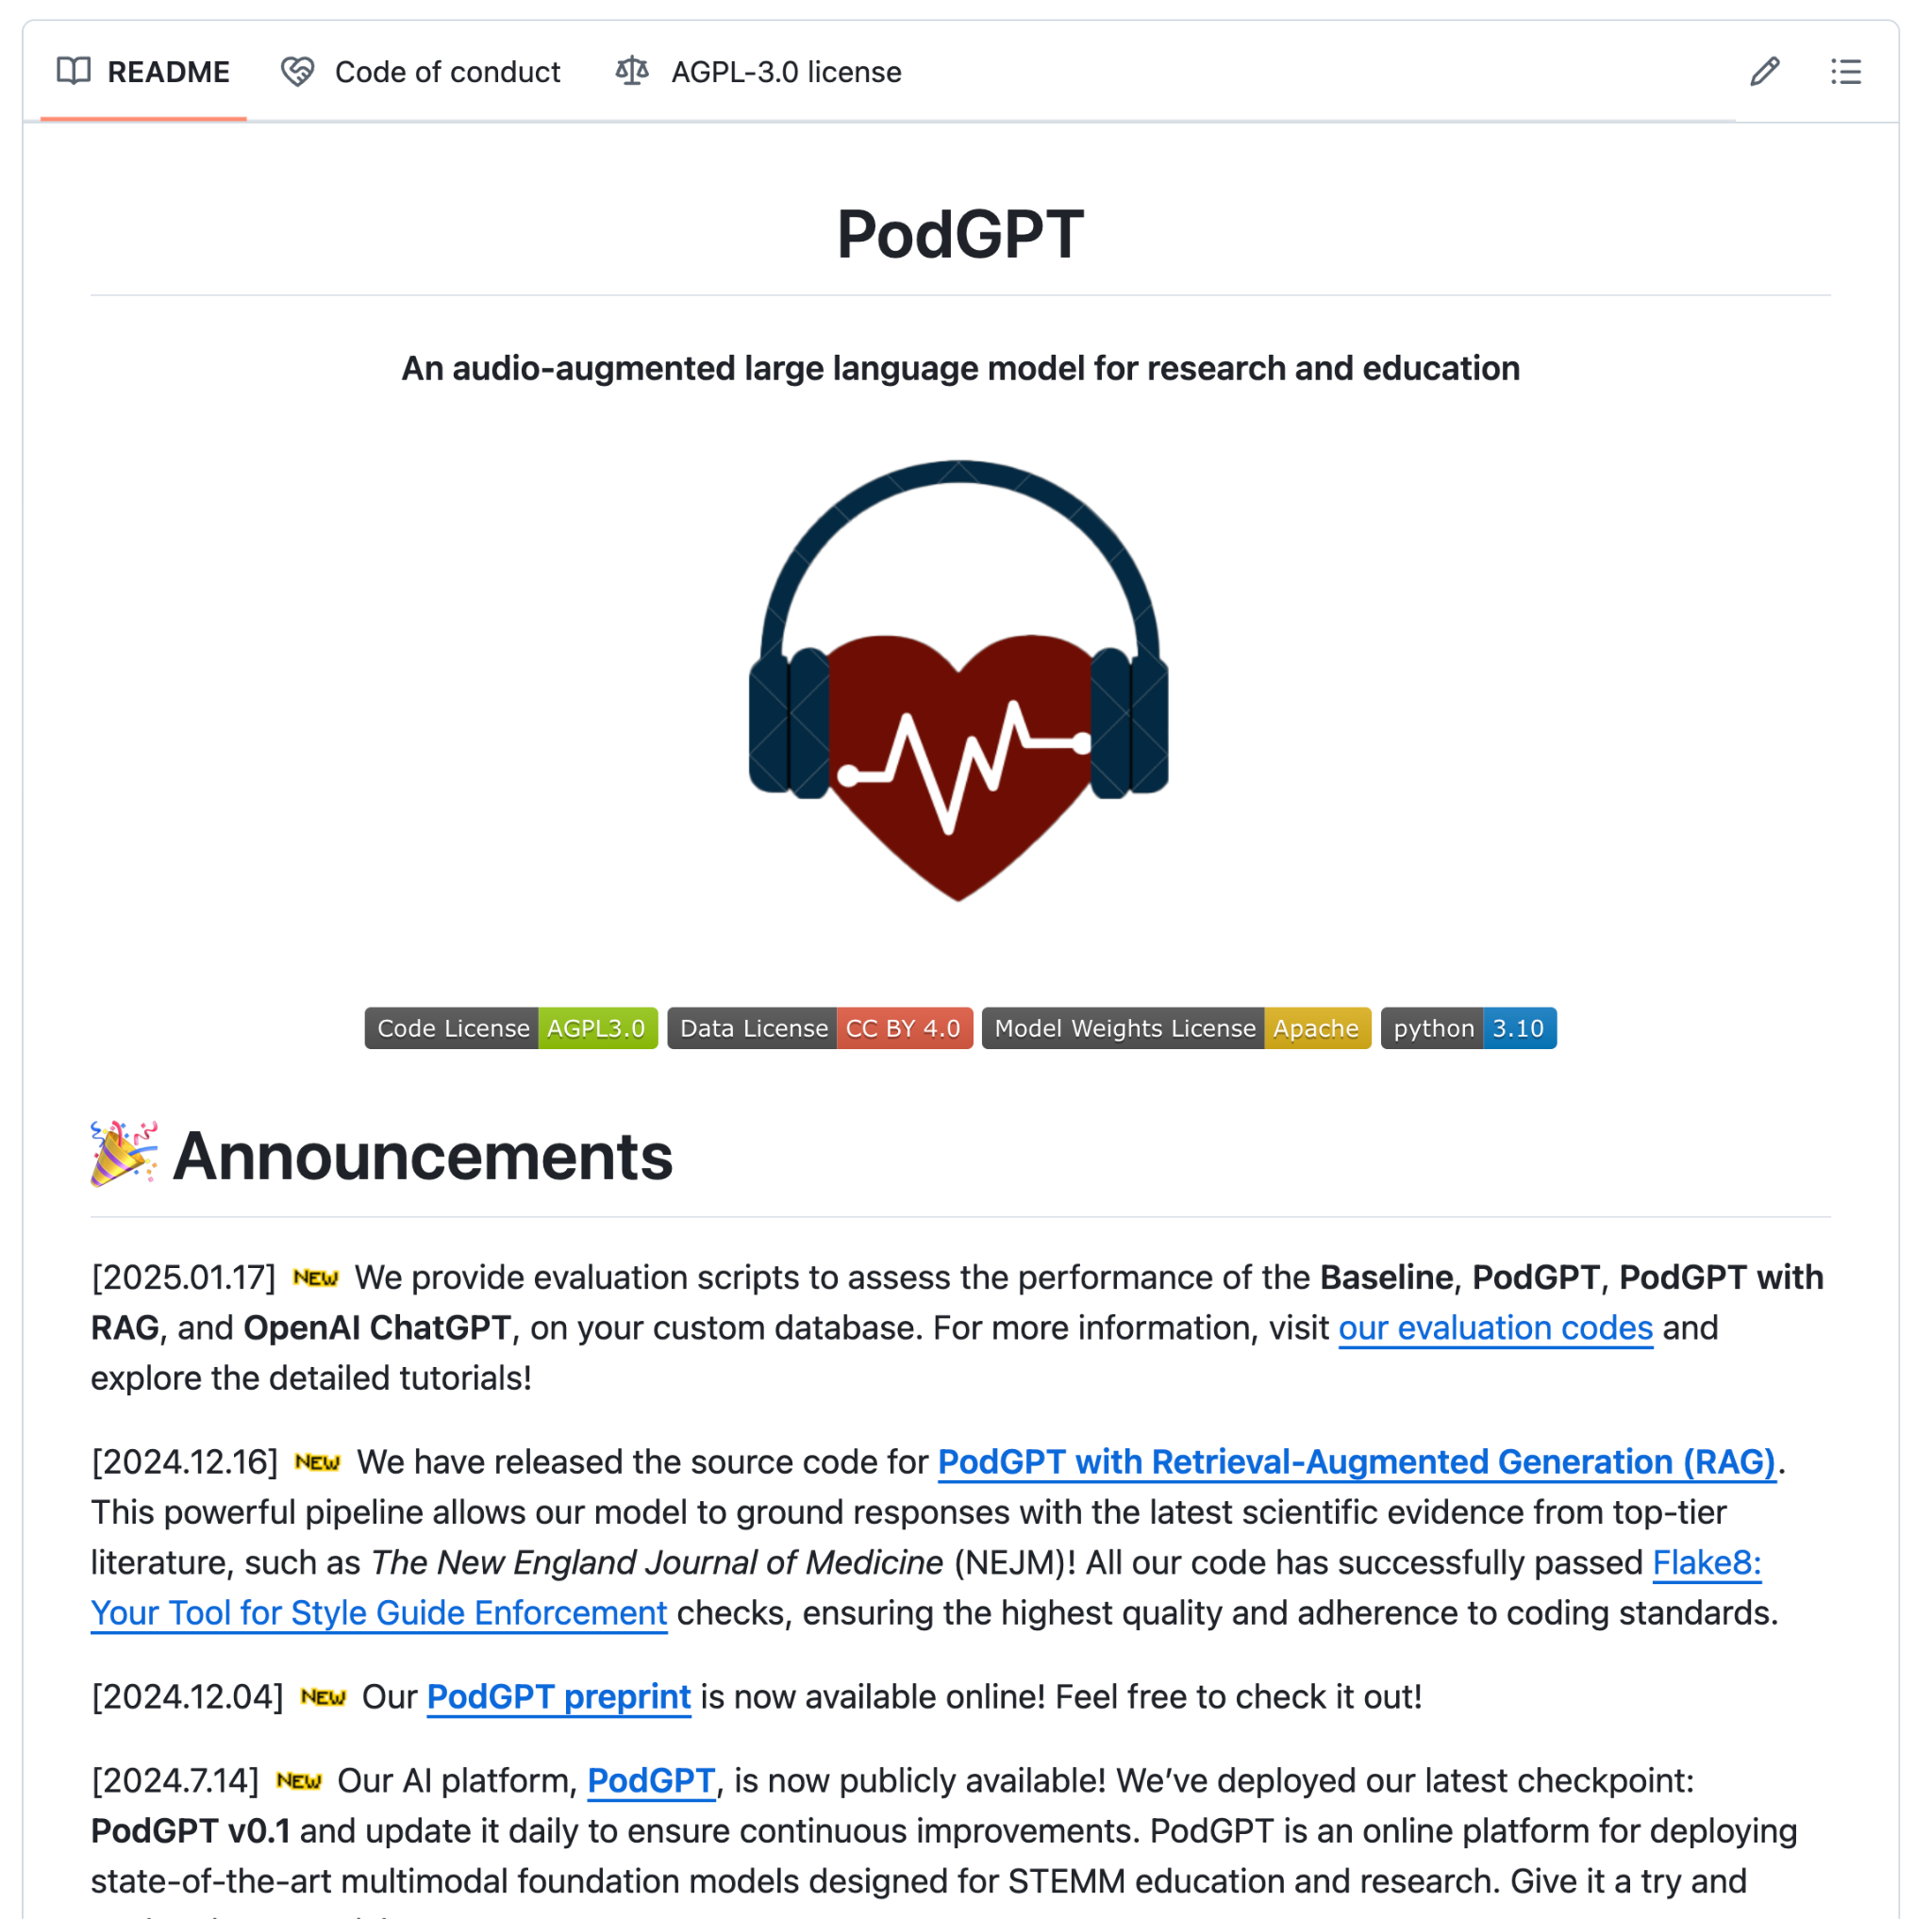
Part 6 - README Examples
Demo: https://github.com/vkola-lab/PodGPT
Formatted Title
Fancy Logo
News & Announcements
Table of Content
Fancy Figures
Codes Block
Tables
Structure of the Codes
Citation
Contact
Contributions
Acknowledgement
Code of Conduct
License

Slide 35
GitHub
“collaborative, open sharing
in the programming world”

Slide 36
Thank you very much for your attention!

